Slide 1
Special Review: Australia’s climate policy options
Webinar 3 February 2016
Shayleen Thompson – Acting CEO
Kath Rowley – General Manager

Slide 2
Special Review
Minister for Environment requested a Special Review to:
Provide recommendation on targets (completed)
Assess whether Australia should have an emissions trading scheme
Recommending action Australia should take to implement outcomes from the Paris Summit
Final report due 30 June 2016

Slide 3
Climate change impacts in Australia

Slide 4
Context for the Review
Paris outcome
nearly 190 countries pledged to reduce emissions
stronger, more specific global goal
limit warming to well below 2 degrees and try to limit to 1.5 degrees
peak emissions as soon as possible, and net zero in second half of century
regular global stocktake: first in 2018 then every five years
five yearly national pledges: must build on ambition over time
Australia’s contribution
Government’s 2030 target: 26-28 per cent below 2005 levels
broad recognition new policies needed to meet target
Government policy and target review in 2017

Slide 5
Pledges will make a difference

Slide 6
Pledges will make a difference

Slide 7
Pledges will make a difference, but not enough to meet 2 degree limit

Slide 8
Policy Toolkit

Slide 9
Types of policy
Market policies
Mandatory carbon pricing
Voluntary carbon pricing
Other mandatory price-based policies e.g. RET, energy efficiency certificates
Non-market policies
Regulation e.g. mandatory standards
Information programs
Innovation support

Slide 10
Emissions trading

Slide 11
Mandatory carbon pricing
Internalise costs of emissions
Reduce emissions cost-effectively
Can raise revenue
Scalable
Emissions trading
Sets quantity of emissions
Requires market infrastructure
Carbon tax
Sets price

Slide 12
Other types of market policies
Voluntary carbon pricing
Offset schemes e.g. Emissions Reduction Fund, may link to government purchasing schemes
Other mandatory price-based policies
Renewable energy target schemes with tradeable certificates e.g. the RET
Energy efficiency targets schemes with tradeable certificates e.g. NSW Energy Savings Scheme

Slide 13
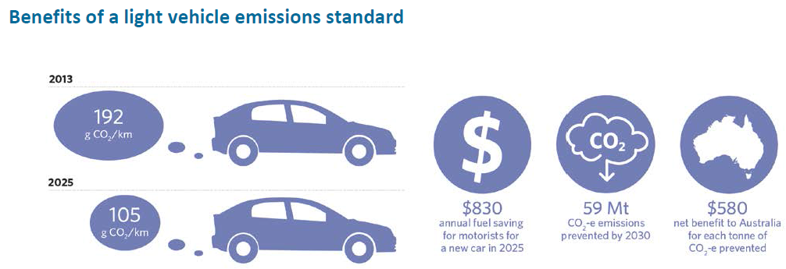
Types of non-market policies
Regulation
Facility-level emission limits
Standards for appliances; buildings; vehicles

Slide 14
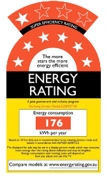
Types of non-market policies - cont
Information programs
Energy labelling for appliances
Information and advice on energy efficiency
Innovation support
Grants for research & development
Investment to assist commercialisation of products
e.g. ARENA, CEFC

Slide 15
Policy evaluation
Environmental effectiveness
Carbon leakage
International units
Cost effectiveness
‘Least cost’
Not just direct costs
Scalability
Equity
How costs are distributed
Other considerations
Competitiveness
fit to sectors
policy interactions, etc

Slide 16
Competitiveness concerns
Arise where policy in different countries creates different costs for firms operating in the same markets
Can design policy to address these concerns e.g. provide assistance to affected firms
Have to balance against impacts on other evaluation criteria

Slide 17
Consultation process
Submissions due by 19 February 2016
submissions@climatechangeauthority.gov.au
www.climatechangeauthority.gov.au
Like us @Climate Change Authority
Follow us on Twitter @Aus_CCA

Slide 18
Other slides

Slide 19
Terms of reference
Should Australia have an emissions trading scheme?
If so what should trigger the introduction
Whether key countries have established schemes
Australia’s international undertakings
International competitiveness

